Slide 1
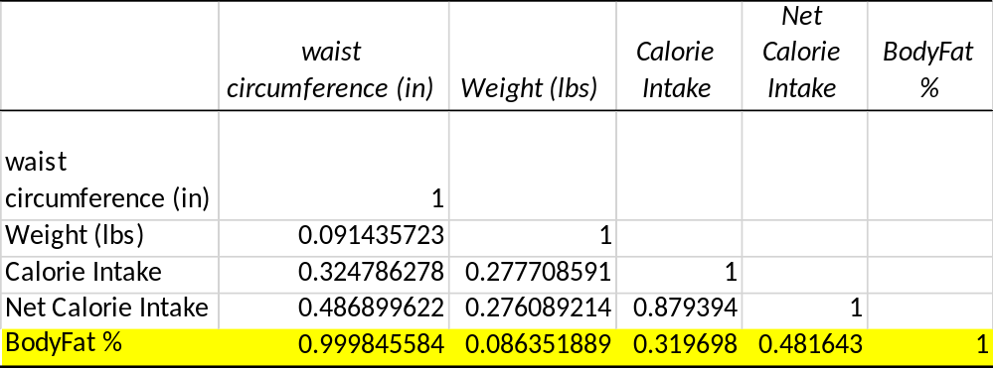
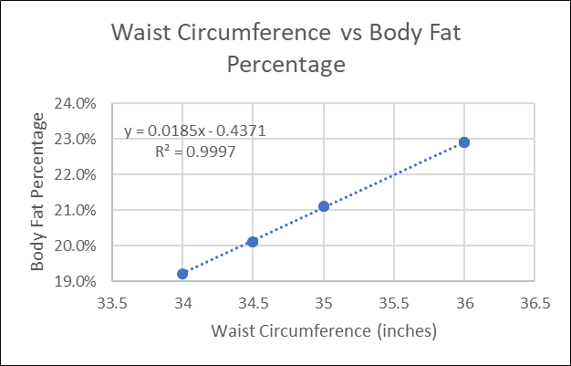
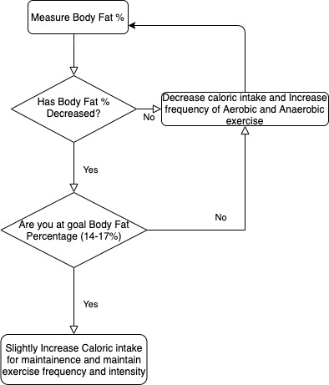
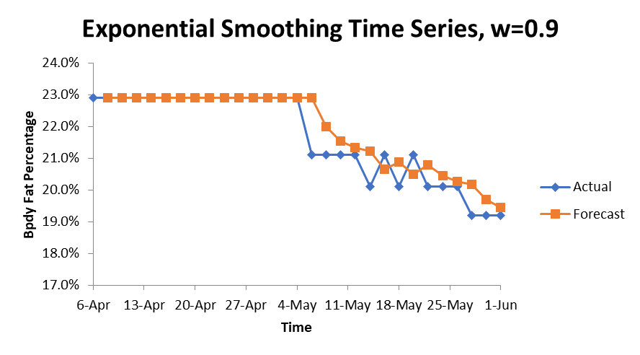
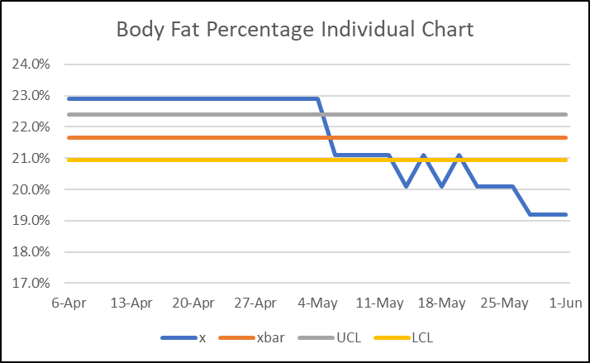
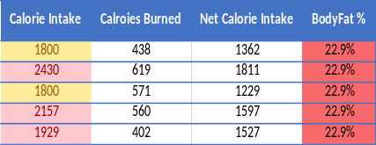
MBC638
Data Analysis and Decision Making
Reduction of Body Fat Percentage
Process owner: Andrew Morcos
Key Dates --->
Team Launch: 03/30
Define: 03/30
Measure: 04/06-06/01
Analyze: 06/01
Improve: 06/08
Control: 06/09
DEFINE
MEASURE
ANALYZE
IMPROVE
Purpose: Decrease Body Fat Percentage
Type of Data : Continuous and Discreet
Most correlated with BF%:
Waist Circumference; r= 0.99
Net Calorie Intake; r= 0.48
Keep monitoring caloric intake
Impact:
Prevent health risks
Better fit of clothing
Elimination of processed foods
Collection: different body measurements to calculate body fat percentage and net caloric intake
SQL = 3.9
Process Improvement
Output (y): body fat percentage
Hypothesis test came back inconclusive with the allotted time
Goal: Reaching the body fat percentage range of 14-17%
Input (x): hours spent Exercising, Net Calorie Intake and Resting Heart Rate
CONTROL
SQL = 3.4
Defect: Deviation from diet causing bloating and increase in waist circumference, calorie intake and decrease in Net Calorie intake.
Team Members: Myself
Time Series can be used to determine when goal BF% can be reached
Baseline for output (y):
Mean = 21.6%
SD = 1.4%

Slide 2
-DEFINE-
Problem Statement & Impact
The purpose of this process improvement project is to reduce body fat percentage to a healthy range.
Personal/Financial Impact:
  Prevention of health risks (i.e. hypertension, heart disease, diabetes, osteoporosis)
  Elimination of processed foods
  Better fit of clothing
  The former three points impact financially to save on medical/prescription bills from chronic diseases, saving on outside food purchases and clothing purchases.
Goal:
  To reach a body fat percentage between 14-17% which is considered fit for adult males by the American Council on Exercise.
Team:
  Only me, the process owner

Slide 3
-DEFINE-
Process Map

Slide 4
-DEFINE-
Operational Definitions
Output (y)
Defect: Days without exercising, deviation from diet causing bloating and increase in waist circumference, calorie intake and decrease in Net Calorie intake.
Body Fat Percentage: the percent composition of the body that is fat (essential fat + excess fat)
Waist Circumference: the measurement around the waist at the navel level
Neck Circumference: the measurement around the neck
Weight: body weight
Resting Heart Rate (HR): Heart rate at rest within the normal range of 70-100 beats per minute (bpm)
Exercise time: time spent exercising per day
Aerobic/Anaerobic exercise: the type of exercise performed that given day whether it is a run and jump rope or strength training, respectively.
Net Calorie Intake: The difference between the Calories consumed and Calories burned through exercise in one day
During the data collection process, this was the most significant factor in reduction of body fat percentage

Slide 5
-MEASURE-
Identifying the Data
Type of Data: Due to health related measurements majority of data is continuous data however, some data is categorized into discreet data (resting HR: low, normal, high).
Data Collection: I collected data on my own using my own health related measurements. All data collected is my own personal health information. The data was collected every other day in the morning after waking up: waist circumference, neck circumference, weight, and then calculating body fat percentage using the naval body fat percentage calculator.
Data Sample size: The sample size of the data is over a 8-week period (56 days). The ideal sample size would have been over a 20-week period to reach the goal body fat percentage range. The risk of of fewer samples is not having enough information to adjust exercise and diet.
Output (y): The output used to measure success is the body fat percentage.

Slide 6
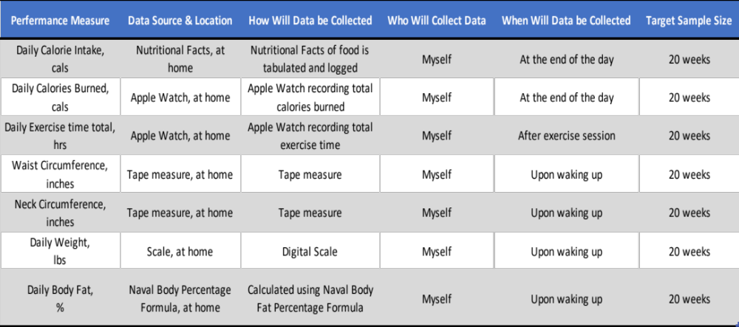
-MEASURE-
Data Measurement Plan
This data measurement plan outlines the key factors that affect body fat percentage

Slide 7
-MEASURE-
Data Set & Input
Potential Inputs (x’s): I wanted to find out which inputs had the greatest affect on my output (y), body fat percentage, to find out later what needs improvement for greatest results of output (y).
  waist circumference (in)
  neck circumference (in)
  Weight (lbs)
  Resting Heart Rate (bpm)
  Resting Heart Rate (High, Normal, Low)
  exercise (hours)
  Aerobic/anaerobic
  Calorie Intake
  Calroies Burned
  Net Calorie Intake

Slide 8
-MEASURE-
Data Set & Input
Baseline for output (y):
Mean = 21.6%
SD = 1.4%
Day | Date | waist circumference (in) | neck circumference (in) | Weight (lbs) | Resting Heart Rate (bpm) | Resting Heart Rate (High, Normal, Low) | exercise (hours) | Aerobic/anaerobic | Calorie Intake | Calroies Burned | Net Calorie Intake | BodyFat %
0 | 6-Apr | 36 | 15 | 174.4 | 71 | Normal | 2 | Aerobic | 1800 | 790 | 1010 | 22.9%
2 | 8-Apr | 36 | 15 | 172.2 | 70 | Normal | 2 | Aerobic | 2430 | 627 | 1803 | 22.9%
4 | 10-Apr | 36 | 15 | 172.2 | 70 | Normal | 2 | Aerobic | 1800 | 692 | 1108 | 22.9%
6 | 12-Apr | 36 | 15 | 172.0 | 69 | Normal | 2.5 | Aerobic | 2157 | 597 | 1560 | 22.9%
8 | 14-Apr | 36 | 15 | 172.0 | 65 | Normal | 2 | Aerobic | 1929 | 643 | 1286 | 22.9%
10 | 16-Apr | 36 | 15 | 171.9 | 63 | Normal | 2 | Anaerobic | 1800 | 492 | 1308 | 22.9%
12 | 18-Apr | 36 | 15 | 171.8 | 65 | Normal | 2 | Anaerobic | 1800 | 583 | 1217 | 22.9%
14 | 20-Apr | 36 | 15 | 172.0 | 64 | Normal | 1.5 | Anaerobic | 1883 | 300 | 1583 | 22.9%
16 | 22-Apr | 36 | 15 | 169.0 | 63 | Normal | 1.5 | Anaerobic | 1800 | 459 | 1341 | 22.9%
18 | 24-Apr | 36 | 15 | 168.6 | 63 | Normal | 1.5 | Aerobic | 2075 | 782 | 1293 | 22.9%
20 | 26-Apr | 36 | 15 | 168.6 | 64 | Normal | 1.5 | Aerobic | 1800 | 757 | 1043 | 22.9%
22 | 28-Apr | 36 | 15 | 169.0 | 64 | Normal | 2 | Anaerobic | 1800 | 623 | 1177 | 22.9%
24 | 30-Apr | 36 | 15 | 169.0 | 64 | Normal | 2 | Anaerobic | 1800 | 553 | 1247 | 22.9%
26 | 2-May | 36 | 15 | 169.0 | 63 | Normal | 2 | Anaerobic | 1683 | 610 | 1073 | 22.9%
28 | 4-May | 36 | 15 | 169.0 | 62 | Normal | 1 | Anaerobic | 1683 | 619 | 1064 | 22.9%
30 | 6-May | 35 | 15 | 169.0 | 62 | Normal | 1.5 | Anaerobic | 1683 | 445 | 1238 | 21.1%
32 | 8-May | 35 | 15 | 169.0 | 62 | Normal | 1 | Aerobic | 1683 | 503 | 1180 | 21.1%
34 | 10-May | 35 | 15 | 169.0 | 62 | Normal | 1.5 | Aerobic | 1683 | 622 | 1061 | 21.1%
36 | 12-May | 35 | 15 | 169.0 | 59 | Athletic | 1.5 | Anaerobic | 1683 | 437 | 1246 | 21.1%
38 | 14-May | 34.5 | 15 | 169.0 | 58 | Athletic | 1.5 | Anaerobic | 1683 | 338 | 1345 | 20.1%
40 | 16-May | 35 | 15 | 170.0 | 58 | Athletic | 1.5 | Anaerobic | 1683 | 501 | 1182 | 21.1%
42 | 18-May | 34.5 | 15 | 170.4 | 58 | Athletic | 1.5 | Anaerobic | 1683 | 580 | 1103 | 20.1%
44 | 20-May | 35 | 15 | 170.4 | 58 | Athletic | 1 | Anaerobic | 1683 | 301 | 1382 | 21.1%
46 | 22-May | 34.5 | 15 | 170.4 | 58 | Athletic | 1.5 | Anaerobic | 2400 | 465 | 1935 | 20.1%
48 | 24-May | 34.5 | 15 | 171.0 | 58 | Athletic | 2 | Anaerobic | 1683 | 402 | 1281 | 20.1%
50 | 26-May | 34.5 | 15 | 171.0 | 58 | Athletic | 1 | Anaerobic | 1683 | 560 | 1123 | 20.1%
52 | 28-May | 34 | 15 | 171.0 | 58 | Athletic | 1 | Anaerobic | 1683 | 571 | 1112 | 19.2%
54 | 30-May | 34 | 15 | 171.0 | 58 | Athletic | 1 | Anaerobic | 1683 | 619 | 1064 | 19.2%
56 | 1-Jun | 34 | 15 | 171.0 | 58 | Athletic | 1.5 | Anaerobic | 1683 | 438 | 1245 | 19.2%

Slide 9
-MEASURE-
SQL & Measurement Error
Sigma Quality Level (SQL): I calculated the baseline SQL against which to measure the end result after making process changes.
D= 4 (opportunities to affect body fat percentage reduction)
U= 56 day (time frame)
D x U = 224 | <-- total defect opportunities
A = 6 (total number of actual defects)
DPO = A/DU | 0.02678571
DPMO= | 26785.7143
The baseline SQL for my process is 3.4
Measurement Error: The largest potential source of measurement error was the finding out the correct calorie intake when the diet first started. Also some days where the diet plan was not followed affected the Net Calorie Intake.

Slide 10
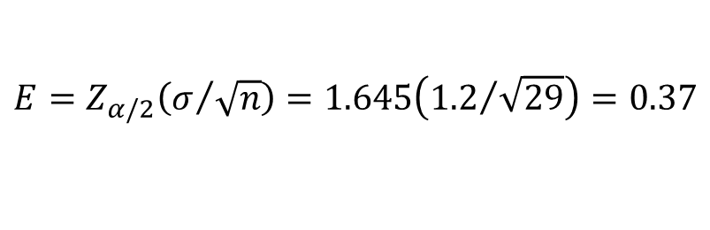
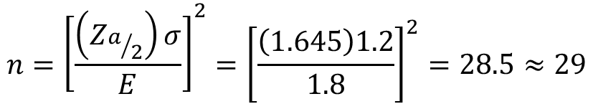
-MEASURE-
Reducing Error & Sample Size
Sample Size:
  Due to the fact that bodily processes such as metabolism is different depending on the participant, there is almost no way to avoid trial and error and making adjustments to diets without ample time and greater sample size. The first month of data collection showed little results, so a modification to macros and reduction in calories were made and showed great improvement with a proper exercise regimen.
  My goal in terms of sample size was to collect at least 20 weeks worth of data, but I was limited to 8 weeks. On average, 1-3% loss of body fat per month so reaching the goal body fat percentage range of 14-17% was not feasible.
90% Confidence Interval Margin of Error:
90% Confidence Interval Sample Size Calculation:

Slide 11
-ANALYZE-
Simple Linear Regression
I attempted a correlation analysis amongst the inputs (x’s) with my output (y). As shown in the highlighted row of body fat percentage (y), the near perfect correlation was waist circumference and next was weight.
I initially predicted that Net Calorie Intake would have a strong correlation but due to different workouts and energy exertion and lack of control of calories burned, it was difficult to develop an analytical correlation, although medical journals indicate that Net Calorie Intake has the biggest significance in Body Fat Percentage reduction.

Slide 12
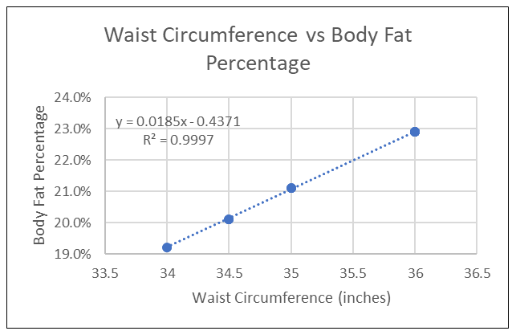
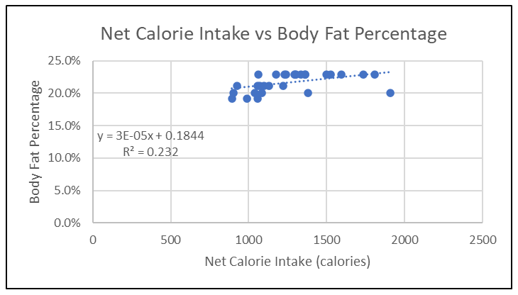
-ANALYZE-
Simple Linear Regression
Waist Circumference with a near perfect correlation to Body Fat Percentage was suspected due to the waist area holding the most fat in an average human. It is safe to say that there is a direct correlation with Waist Circumference and Body Fat percentage with 99.9% variability.
On the other hand, Net Calorie Intake has a correlation of 0.481 and a variability of 23.2% to Body Fat Percentage.

Slide 13
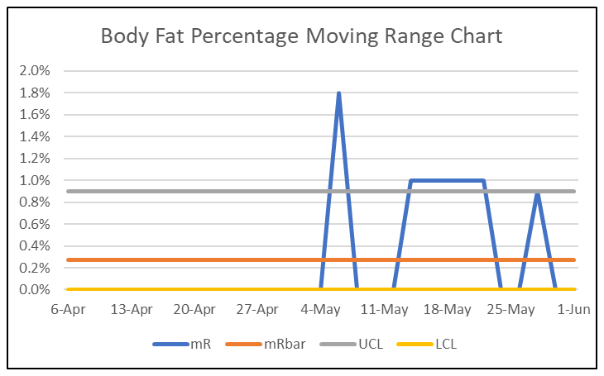
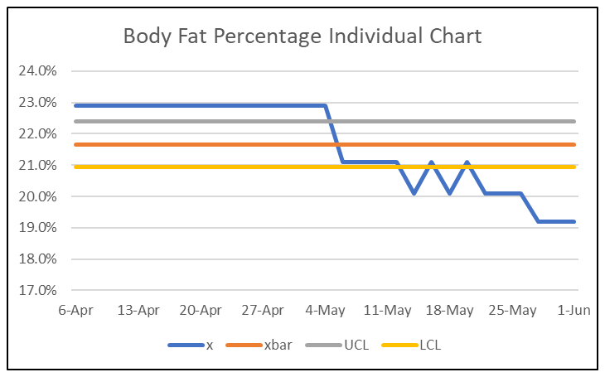
-ANALYZE-
Control Chart Analysis
According to both the Moving Range Chart and Individual Chart, it was hard to control the reduction of Body Fat Percentage possibly due to the lack of time to adjust and find a consistent regimen that the human body needs which is different from individual to individual.

Slide 14
-IMPROVE-
Find a Consistent Regimen
The control charts showed the variation and difficulty to control Body Fat Percentage in the allotted time. When there was no decrease in Body Fat Percentage in the first 4 weeks, I implemented a new diet that reduced calorie intake while keeping the same exercise regimen. There were significant changes made but not enough evidence and time to prove that Caloric Intake is a valid input for Body Fat Percentage.
Since there were significant changes made after the Calorie Intake was reduced, as shown in the reduction of Waist Circumference therefore a reduction in Body Fat Percentage

Slide 15
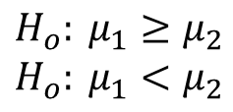
-IMPROVE-
New SQL & Hypothesis Test
Sigma Quality Level (SQL): I then calculated a new SQL against the previous when eliminating deviation from diet over a longer period of time such as 20 weeks or 560 days.
The new SQL for my process is 3.9 an improvement from the previous baseline of 3.4.
Hypothesis Test: I ran a two-sample, continuous, lower/left-tailed test with my first mean of 22.9% and my new mean of 20.7% with α= 0.05 to see if the new mean was meaningful in my hypothesis.
D= 4 (opportunities to affect body fat percentage reduction)
U= 140 day (time frame)
D x U = 560 | <-- total defect opportunities
A = 4 (total number of actual defects)
DPO = A/DU | 0.007142857
DPMO= | 7142.857
mean 1 | 22.9%
mean 2 | 20.7%
n1 | 13
n2 | 16
SD1 | 5.78E-17
SD2 | 0.011301733
T score | 77.86
p value | 1
Due to the p-value not being less than α, I cannot reject Ho and concluded that the new mean is not meaningfully different from the previous mean

Slide 16
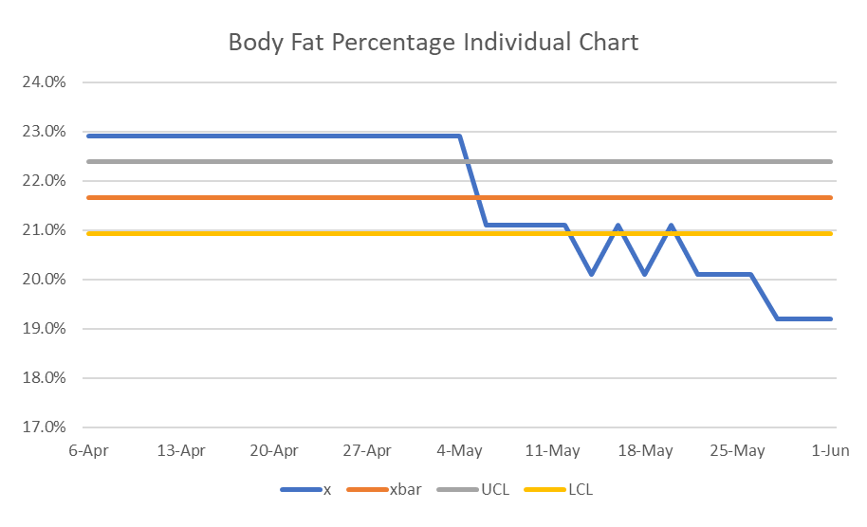
-IMPROVE-
New SQL & Hypothesis Test
Although the previous mean was not significantly different from the new mean, the individual chart below illustrates the improvement when the dietary changes were made as the month of May started.

Slide 17
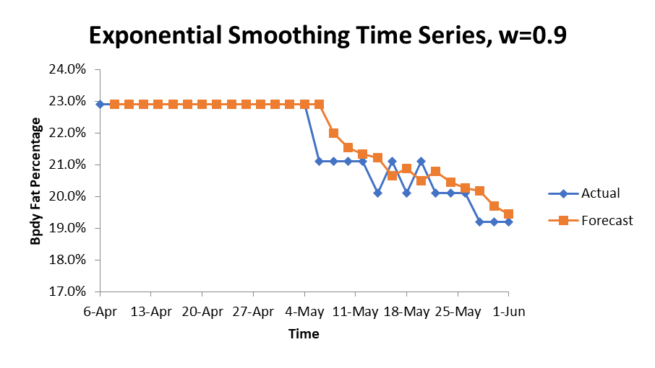
-CONTROL-
Time Series and Future Steps
In the future, I will continue to monitor the decreasing Body Fat Percentage which is correlated to Waist Circumference. The reduction of Calorie intake per day has provided some insight on what to look for as indicated below in the Time Series chart.

